Slide 1
Capture_7he_F1ag
Legal and fun way to Cybersecurity...

Slide 2

What is Hacking?
Basics of CyberSecurity:
A shield : Cybersecurity protects our digital world—devices, networks, and data—from cyber threats like hackers and malware, much like a multi-layered fortress.
What is done to protect? Various fields such as network security (guarding data in transit), application security (securing software), endpoint security (protecting individual devices), and incident response (swiftly countering breaches) comes under the field of CyberSec.
Ever-Evolving Battle: Cybersecurity is a dynamic field where constant innovation meets creative defense strategies as new threats emerge and defenses adapt in real time.
Hacking is the practice of exploring computer systems to understand their inner workings and uncover vulnerabilities.
It is about pushing technological boundaries and continuously evolving in the digital landscape.

Slide 3


Threats :
DDoS Attacks:
Overloading networks with excessive traffic can shut down services, resulting in lost revenue and tarnished reputations.
Malware & Ransomware:
GitHub DDoS Attack (2018), In one of the largest DDoS events, GitHub was hit by an amplified attack peaking at 1.35 Tbps that led to a brief but critical service disruption, stalling code deployments and impacting developers worldwide.
Viruses or Ransomware can cripple systems by corrupting data or locking files until a ransom is paid.
Injection Attacks:
SQL and XSS injection to manipulate databases or web apps.
WannaCry (2017), Exploited a Windows vulnerability to lock up computers worldwide, notably disrupting the UK's NHS and costing billions in losses.
In 2009, attackers exploited a SQL injection vulnerability at Heartland Payment Systems, gaining access to millions of credit card records by manipulating input fields.

Slide 4

Coming to the point now ...
Capture the Flag!
Interactive Learning Environment: CTFs are hands-on competitions where participants solve cybersecurity puzzles by finding hidden "flags" within challenges.
Diverse Competition Formats: They include Jeopardy-style contests (solving independent puzzles in areas like web, crypto, and binary) and attack-defense rounds (simulating real-world system breaches and defenses).
Skill Integration: These events test a broad range of talents—from vulnerability discovery and exploit creation to toolkit development and operational security—merging theoretical concepts with practical application.
Real- World Relevance: Success in CTFs mirrors professional cybersecurity skills, providing valuable experience and acting as an indicator for potential job performance in the field.

Slide 5

How to get into Capturing the Flags?
Learn basics
C/C++
Python
Practice sessions
picoCTF, HTB
Linux terminal
TryHackMe, crackmes.one
Get a hang of it
Play wargames
Discuss problems in groups
Dive into Battle!
Get into any of the live CTF events
Several platforms host CTF events everyday!
Get started
Get used to terminal and tools
Keep track of them at ctftime.org
Just an introduction is enough!
Discord servers have your back!

Slide 6

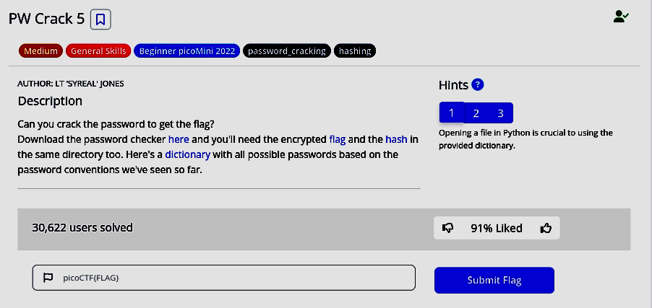
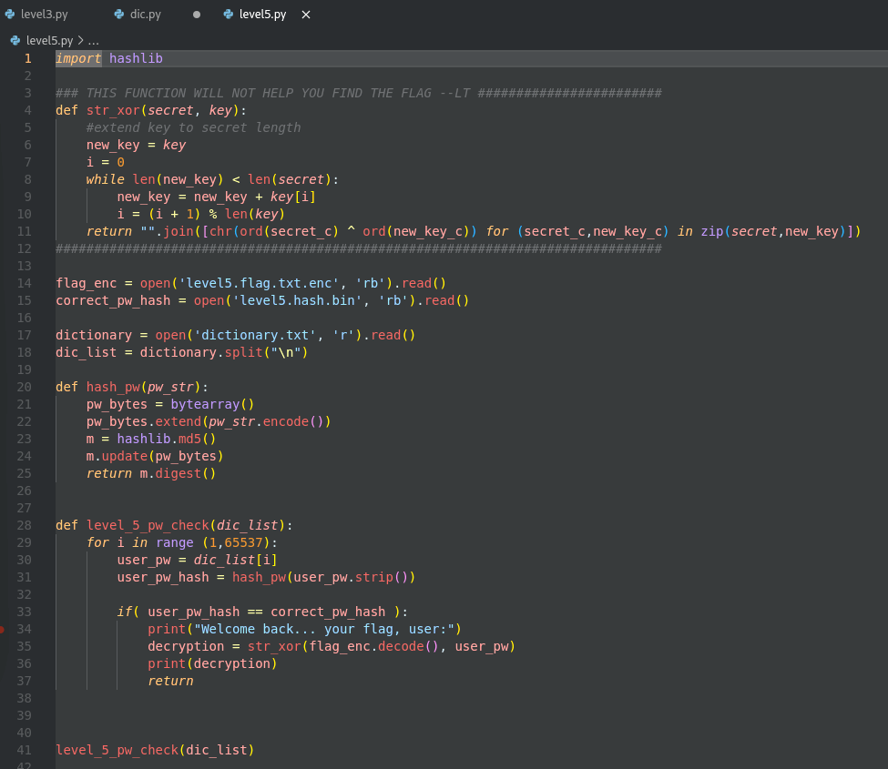
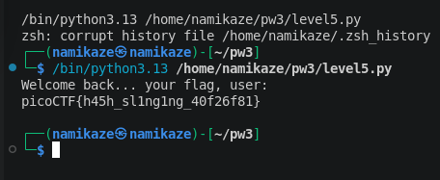
Almost all the CTF challenges have the same structure:
A problem scenario
Makes things real if u imagine them to !
Website link
Binary/exe file
Text file
Exploring and Learning
No pattern here
Get the FLAG!
Flag is a unique string
Something to work upon
You look at things
A proxy server
Find some clues
Work off the hints
May find it hidden somewhere
Maybe it’s distributed in parts throughout the challenge

Slide 7

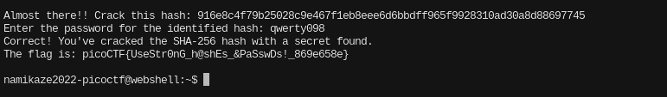
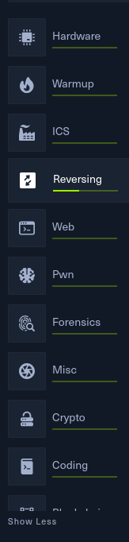
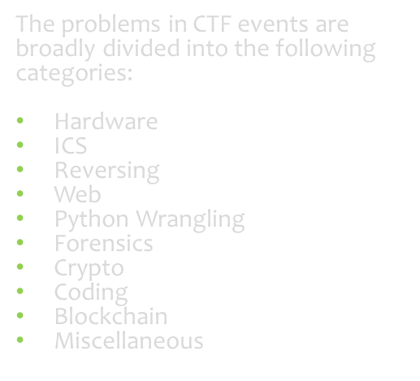
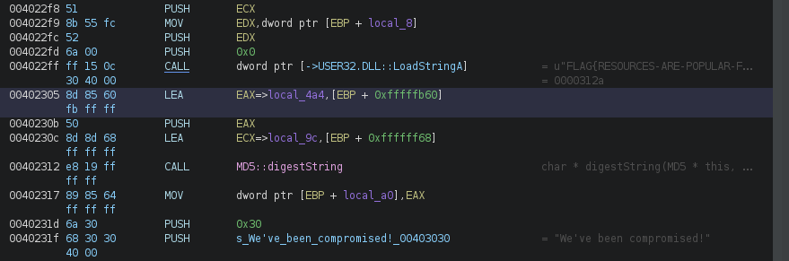
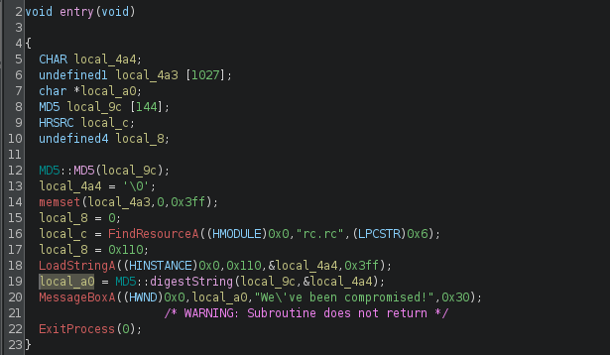
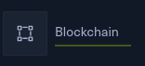
Question types
Challenges we face
Hashes to crack and get the correct passwords...
Analyzing disassembled code from binaries/executables
Understanding decompiled code to reverse engineer the algorithm
#Add one more screenshot from some new challenge type. Maybe crypto or, Web?

Slide 8

Reverse Engineering (RE): A useful skill
One of the more interesting and difficult type of challenge in RE :
Provided a piece of code or any binary/exe file, the task would be to find out how it works modify or reverse the process to accomplish certain things (like obtaining a flag).
Analysing binaries
Challenges may require reverse-engineering algorithms used in the program.
This could involve deciphering encryption methods, compression techniques, or custom logic.
Bypassing Protection
Understanding Algorithms
Participants are provided with a compiled program (e.g., .exe , .bin , or .elf files).
The goal is to understand the program's functionality without access to its source code.
Some challenges include anti-debugging mechanisms or obfuscation techniques.
We may be required to bypass these protections to analyze the program effectively.

Slide 9


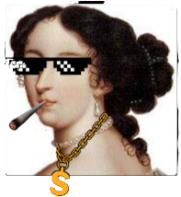







Common tools used for RE:
Executes programs step-by-step in real time.
Sets breakpoints and inspects memory and registers.
Disassembler
Tools like IDA Pro, Ghidra or Radare2 are used to convert binaries into assembly code.
Debuggers
Tools like GDB, OLLY DBG help in through the program’s execution.
Helps bypass anti-debugging techniques.
Tools like Binary Ninja or Hopper attempt to reconstruct source code from binaries.
Decompiler
Converts binary code into assembly language.
Hex Editors
Tools like HxD allow us to view and edit the raw binary data.
Displays file data in hex and ASCII.
Visualizes control flow and functions.
Permits direct byte-level modifications.
Allows annotations for easier analysis.
Converts binaries into high-level pseudocode.
Detects Patterns and embedded signature.
Highlights loops, conditionals and structures.
Accelerates overall code comprehension.

Slide 10


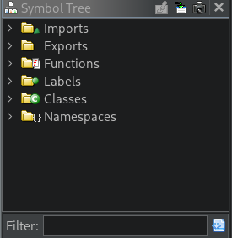
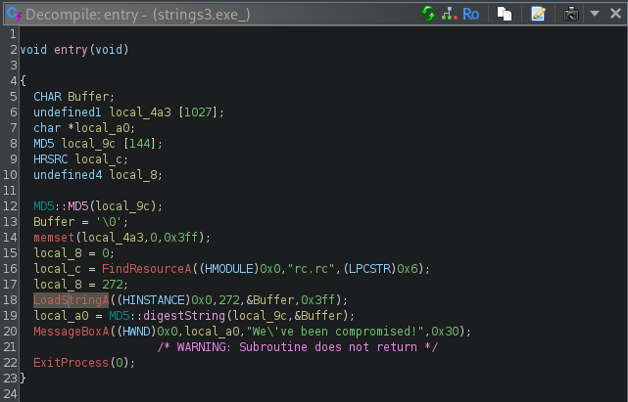
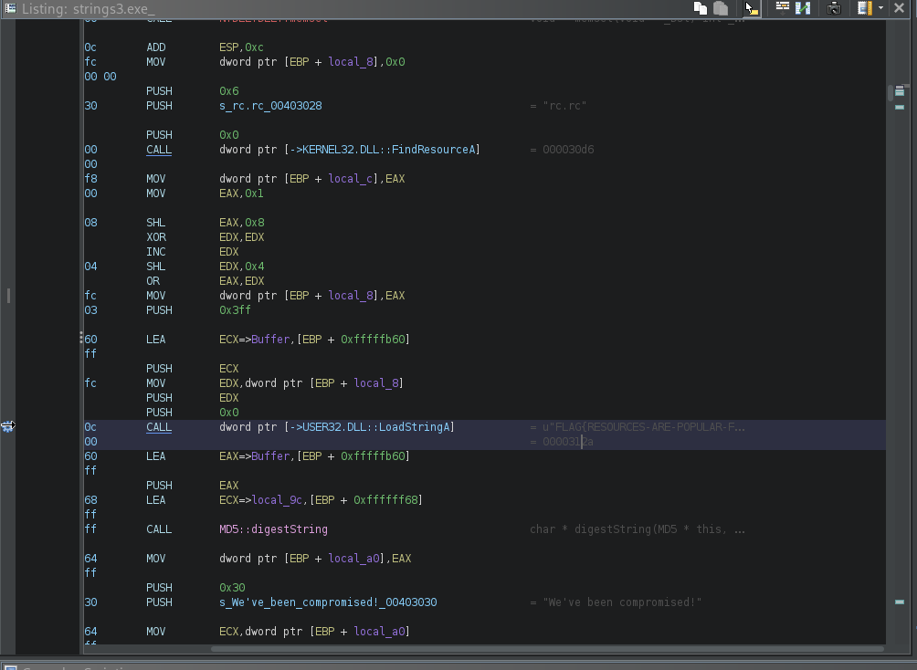
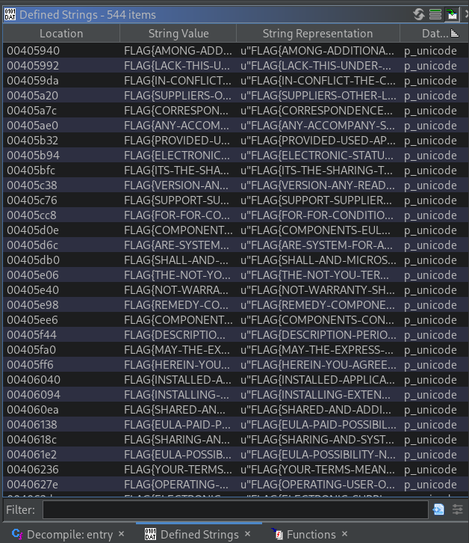
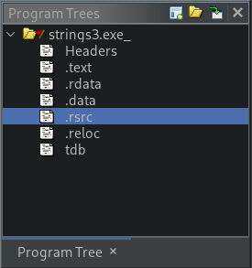
Ghidra: An Open-source Disassembler
By thoroughly examining a binary with Ghidra, we can uncover hidden functions that may not be apparent during runtime.
Additionally, in CTF challenges, Ghidra’s string analysis can quickly reveal function call references or even the flag itself in the Strings view, significantly simplifying the reversing process.
Ghidra is a powerful tool for analyzing binaries and understanding code execution flow through static analysis.
NOTE
Symbols Tree: Displays all the symbols within a program, such as functions, variables, and labels
Decompiler: To view a pseudo source code in C
Disassembly: To view Assembly code form the binary/exe files
Program Tree: Displays the hierarchical organization of memory blocks and sections within a program's binary
Strings view: To find all strings available in the binary header

Slide 11

Techniques used for RE:
Static Analysis (Without Executing the Binary)
Disassembly: Using tools like Ghidra, IDA to analyze assembly code.
Decompilation: Converting binary code back into a high-level language (C, Python).
String Analysis: Extracting human-readable strings to find function calls and flag data.
Symbol Table Analysis: Checking for Function names, global variables, and debug symbols.
Control Flow Analysis: Understanding function calls and loops through CFG(Control Flow Graphs).
Dynamic Analysis (Executing and Observing Behaviour)
Debugger Usage: Using GDB, WinDBG or OllyDBG to set breakpoints and inspect registers/memory.
Tracing Execution: Using tools like strace (Linux) or API Monitor (Windows) to track system calls.
Memory Inspection: Dumping and analyzing process memory with tools like Volatility or Cheat Engine.
Hooking & Patching: Injecting custom code to modify behaviour at runtime.

Slide 12

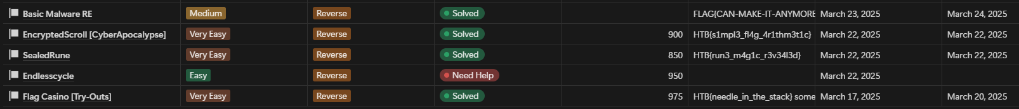
During the past few days:
and many more ...

Slide 13

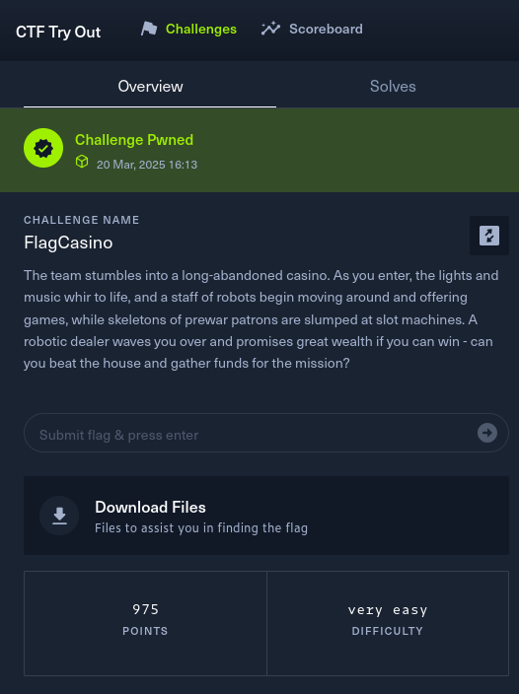
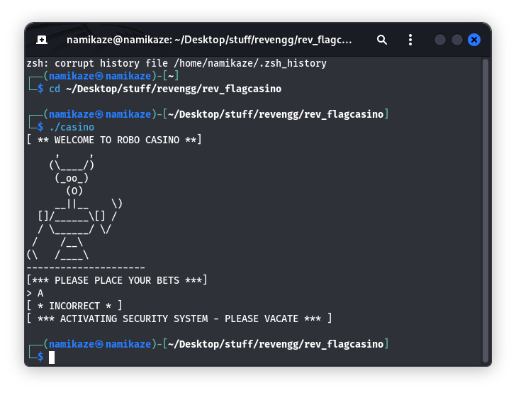
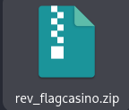
Flag Casino (HTB Try-outs): RE challenge
Provided a zip file containing a single binary named casino.
A problem from CTF Try-out on HackTheBox platform.
Reversing category; Difficulty: Very Easy
On running the binary, I was prompted for an input used a random char ‘A’, to checkout how the program goes. No clue found from this output yet.

Slide 14
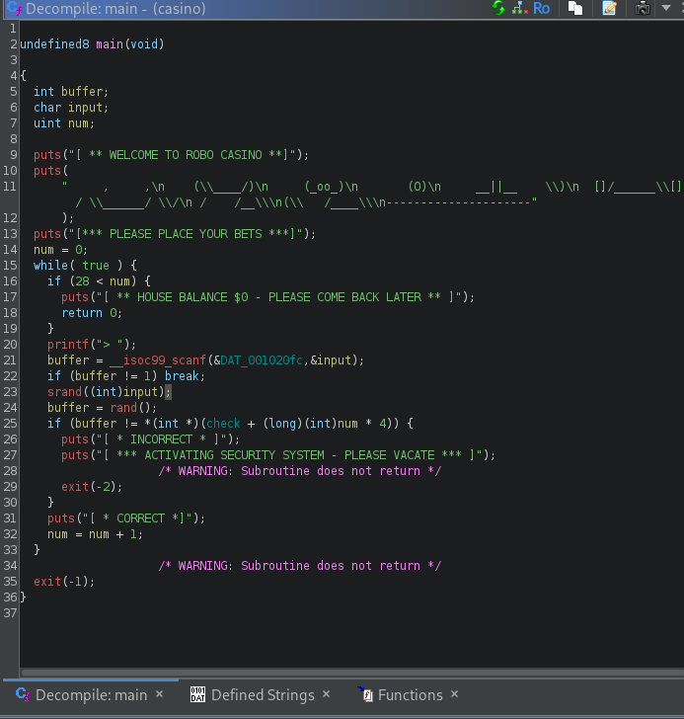
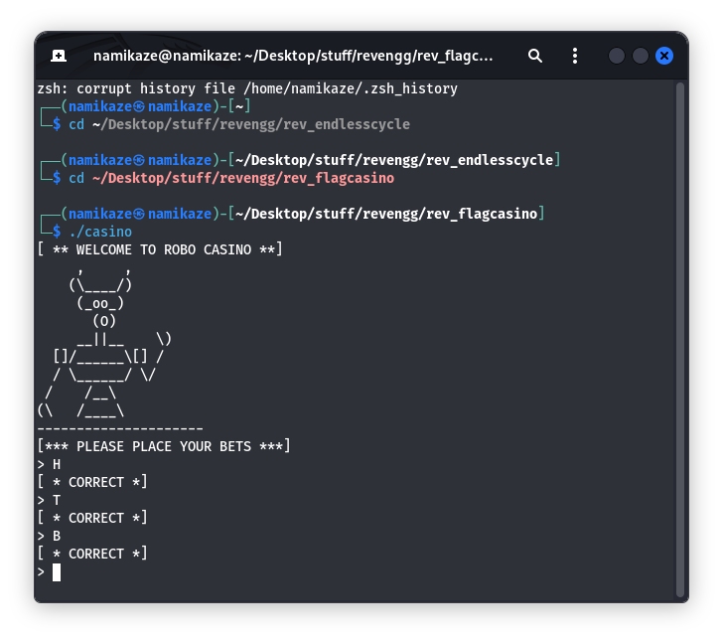
Flag Casino: Continued...
Looking at the decompiled pseudo-code in ghidra, the following points can be noted:
We are supposed to enter a single character for each loop
The loop is supposed to run for 29 times (maybe the length of flag?)
We see that the input char is converted to int and used to seed the rand() function.
Then the number from rand() is compared to the int value stored in resource check
Knowing that all HTB flags have the structure HTB{flag}. I guessed maybe, it’s supposed to check flag as the input. So, I tried the characters H, T, B ... Clue spotted!

Slide 15
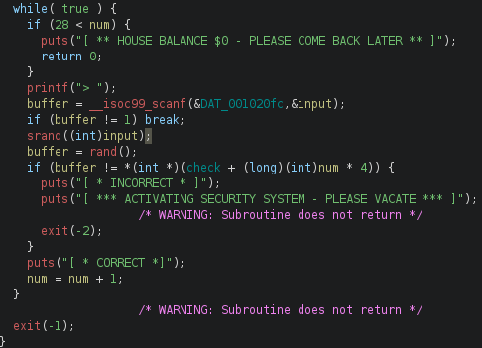
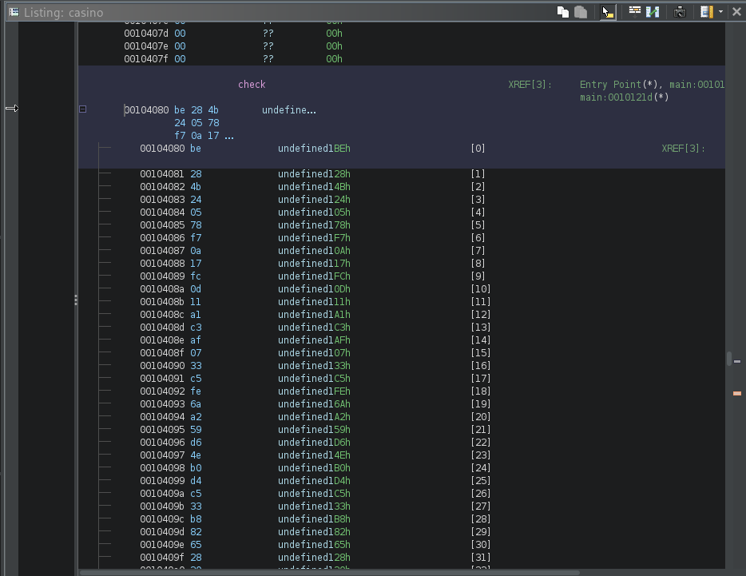
Flag Casino: Continued...
Analyzing the while loop further to understand how the input is checked:
we know that the rand() gives a fixed value for a constant seeding.
the rand() value is stored in buffer which is then compared to check
notice that for each successful iteration, the next comparison is made by moving 4 steps ahead in check.
The check resource contains a series of hex values of undefined data type (this is typecasted to (int *) ) in the code.
So, in each loop the comparison value is moved by 4 bytes in check.

Slide 16
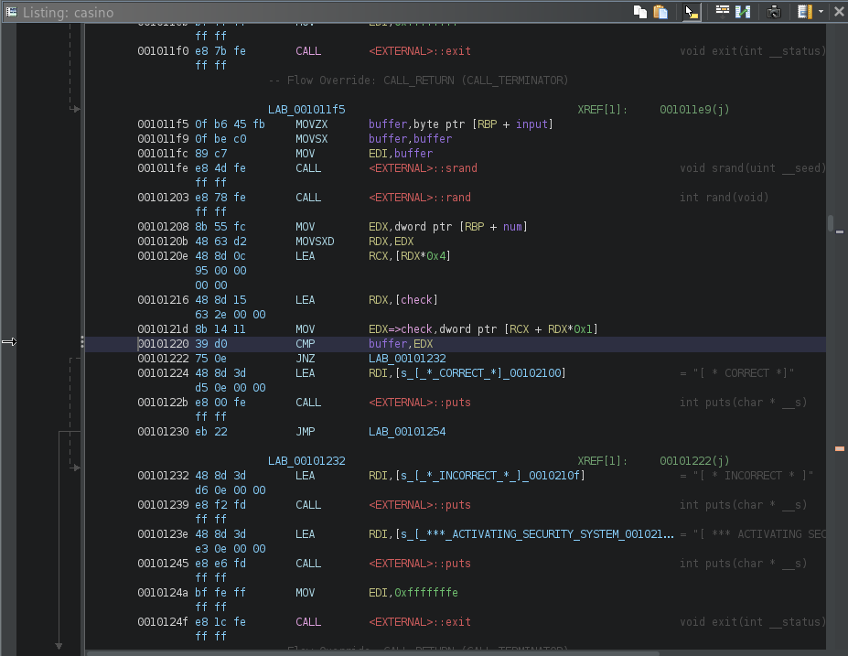

So, can it be done in any other way?
The approach is to make a map of all characters as per their respective rand() index obtained by using the character itself as seed.
Then, all I need to do is get the integer value that check is supposed to compare buffer with, because the character in the map at that index will lead to the flag string (by combining all such characters).
The one thing that comes to mind is to change the source code in such a way that we obtain the values in check, but for that I’d have to change assembly code...which is a rather difficult endeavour .

Slide 17
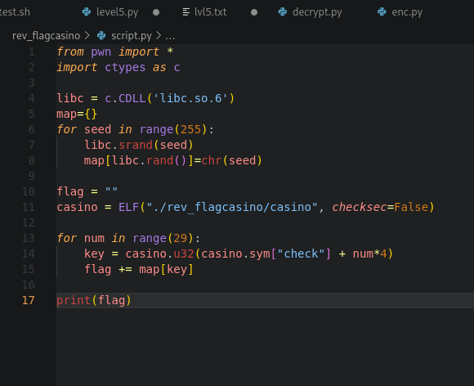
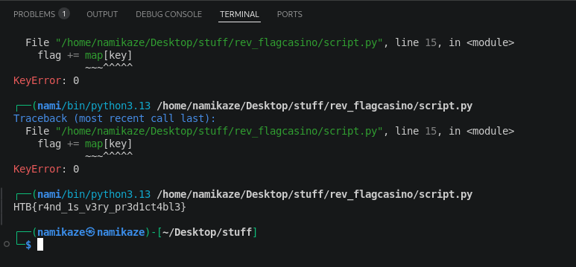
Running the script, the flag itself is directly revealed!
Flag: HTB{r4nd_1s_v3ry_pr3d1ct4bl3}
This python script does that task. Using the pwn library, the data check can be extracted from the binary file. Moreover, the ctypes library enables the use of C functions to emulate the features of obfuscation of string using rand() function.

Slide 18

Key take-aways from this problem:
rand() gives same output for the same seed.
use of pwn library to extract specific data from a binary
brute-forcing such a problem is not a wise approach.

Slide 19

Resources used:
Ghidra for disassembly, Decompilation
HackTheBox for the challenge.
binqqer.com and medium.com for problem writeups.

